Slide 1
Software Product Line Analysis Techniques
Ramy Shahin
Qualifying Oral - March 19th 2018

Slide 2
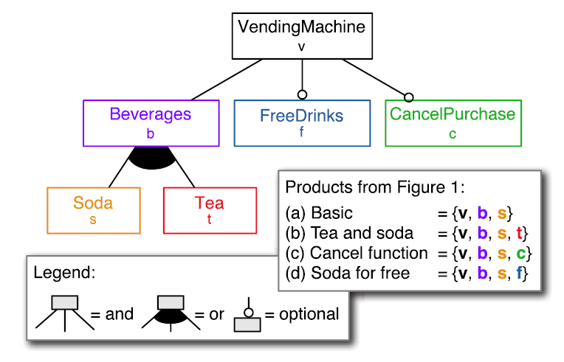
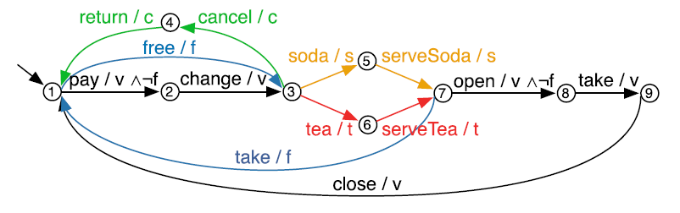
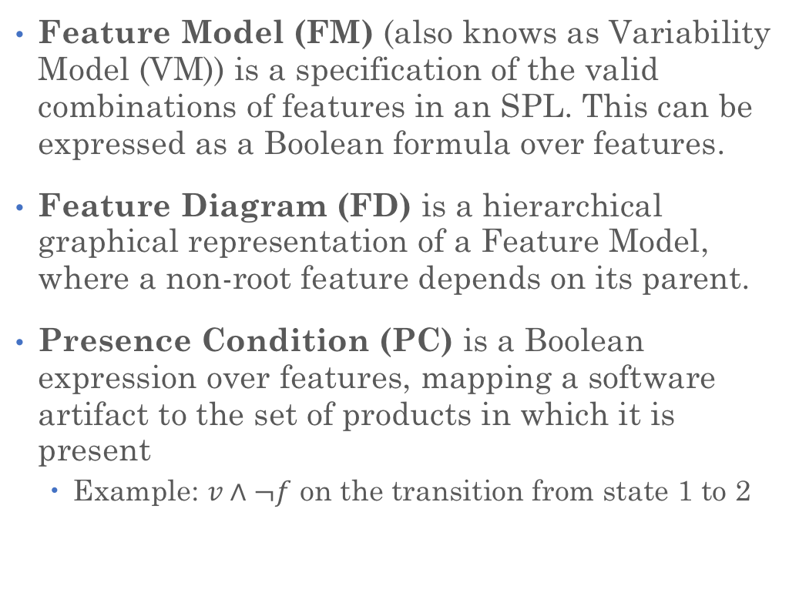
Definitions
Software Product Line (SPL) is a set of similar software products built from a common set of artifacts (e.g., design/specification models, code constructs, test cases, etc...).
Feature is an externally visible property, aspect or quality of a software system.
Feature Model (FM) (also knows as Variability Model (VM)) is a specification of the valid combinations of features in an SPL. This can be expressed as a Boolean formula over features.
Feature Diagram (FD) is a hierarchical graphical representation of a Feature Model, where a non-root feature depends on its parent.
Presence Condition (PC) is a Boolean expression over features, mapping a software artifact to the set of products in which it is present
Example: $v∧¬f$ on the transition from state 1 to 2
Examples:
Many embedded software systems
The Linux kernel
Vending machine (running example)
Examples (vending machine SPL):
Serving tea
Serving soda
Free drinks

Slide 3
Software Analyses
What if our software artifacts come from an SPL?
Model(LTS) + Property(TL)
Source code/binary
Software Artifacts
Source code (AST/CFG)
Model Checker
Type Checker
Analysis
Symbolic Execution Engine
Test cases
Check/Counter-example
Check/TypeError
Useful Info
Example: Symbolic Execution Test Generator
Example: Type Checker
Example: Model Checker

Slide 4
Seven Papers
Paper | Analysis Category | Limitations
Apel et al. | Model Checking | Generative SPLs only
Liebig et al. | Static Analysis | Hand-crafted analyses
Midtgaard et al. | Abstract Interpretation | Systematic but not automated
Kästner et al. | Type Checking | Limited source code variability
Gazzillo and Grimm | Parsing (syntax checking) | Fully hand-crafted
Bodden et al. | Data-flow Analysis | IFDS analyses only
Classen et al. | Model Checking | Hand-crafted
Research Goal: To address the limitations (in particular, to automate lifting)

Slide 5

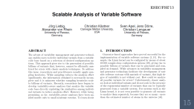
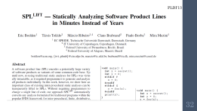
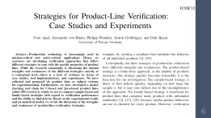
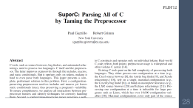
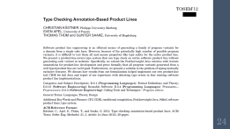
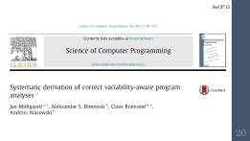

Slide 6
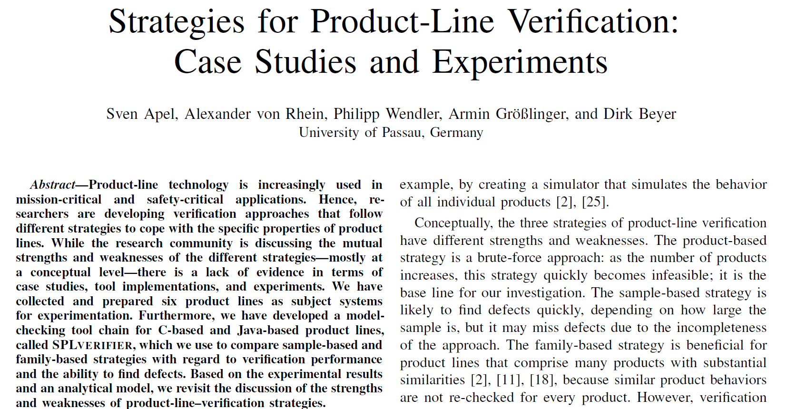
ICSE’13

Slide 7
Strategies for Product-Line Verification
Product-based, sampling-based and family-based
Single-wise, pair-wise and triple-wise sampling
ACC and AspectJ implementations
Existing model checkers (CPAChecker and Java Pathfinder) as is
Generates a new function per configuration
Dispatch function as a level of indirection
Applicable to generative product lines
Supports very basic forms of variability
Notes:
Evaluation: small systems (LOC, features, specifications and # of products)
CPAChecker for C code, Java Pathfinder for Java
Product-based is the baseline
Sampling does not find all defects
In some cases family-based outperform sampling

Slide 8
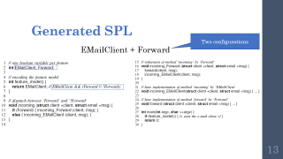
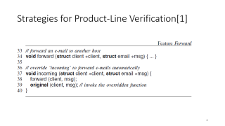
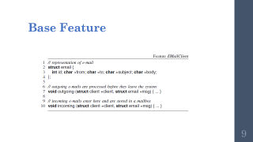
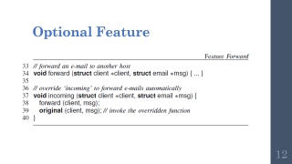
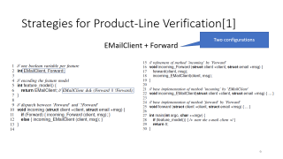
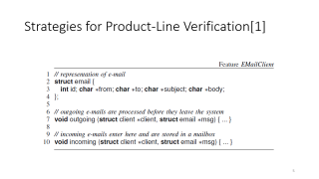
Generative SPLs

Slide 9
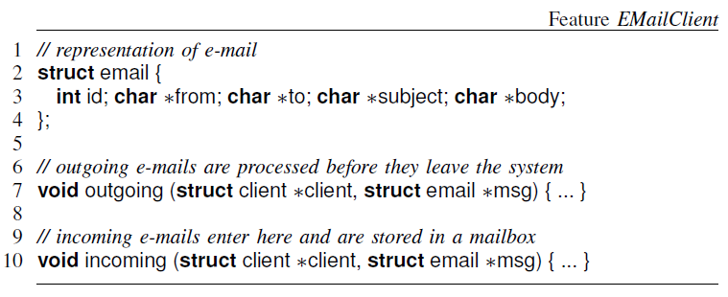
Base Feature

Slide 10
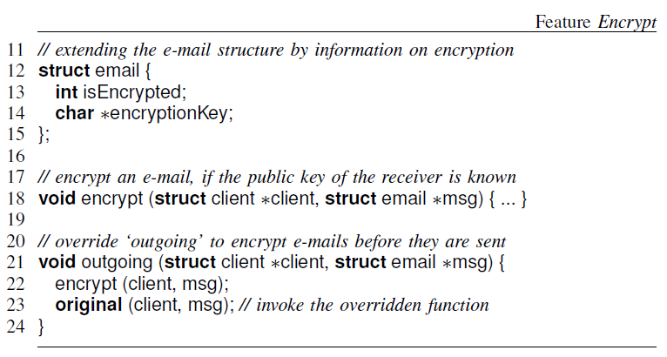
Strategies for Product-Line Verification
Notes:
ICSE’13 – Sven Apel et al. – University of Passau, Germany
Product-based, Sample-based and Family-based strategies

Slide 11
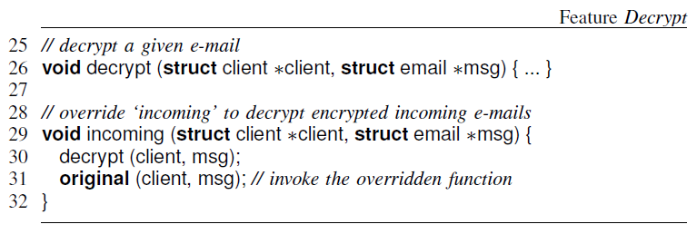
Strategies for Product-Line Verification
Notes:
ICSE’13 – Sven Apel et al. – University of Passau, Germany
Product-based, Sample-based and Family-based strategies

Slide 12
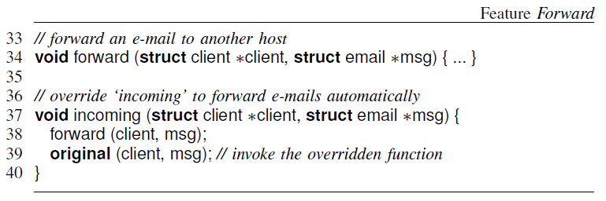
Optional Feature
Notes:
ICSE’13 – Sven Apel et al. – University of Passau, Germany
Product-based, Sample-based and Family-based strategies

Slide 13
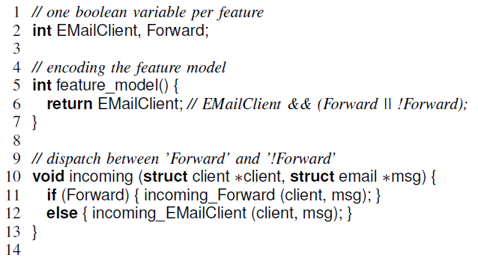
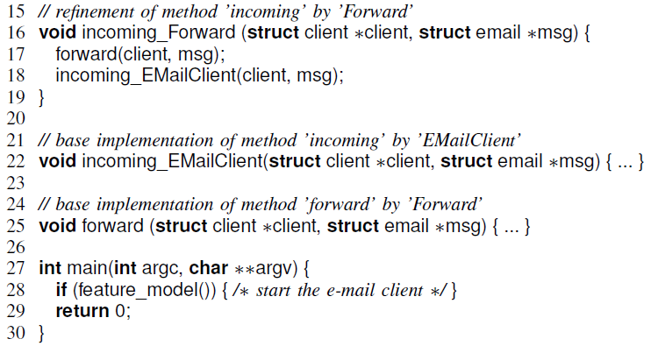
Generated SPL
Two configurations
EMailClient + Forward
Notes:
Aspect weaving
Boolean variable per feature
Feature model predicate
Incoming dispatch function

Slide 14
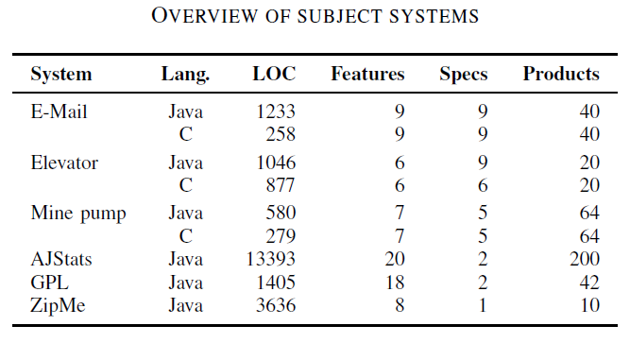
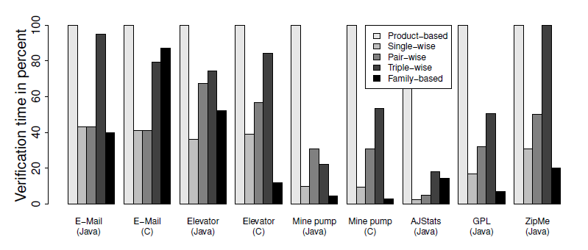
Evaluation
Notes:
Evaluation: small systems (LOC, features, specifications and # of products)
CPAChecker for C code, Java Pathfinder for Java
Product-based is the baseline
Sampling does not find all defects
In some cases family-based outperform sampling

Slide 15
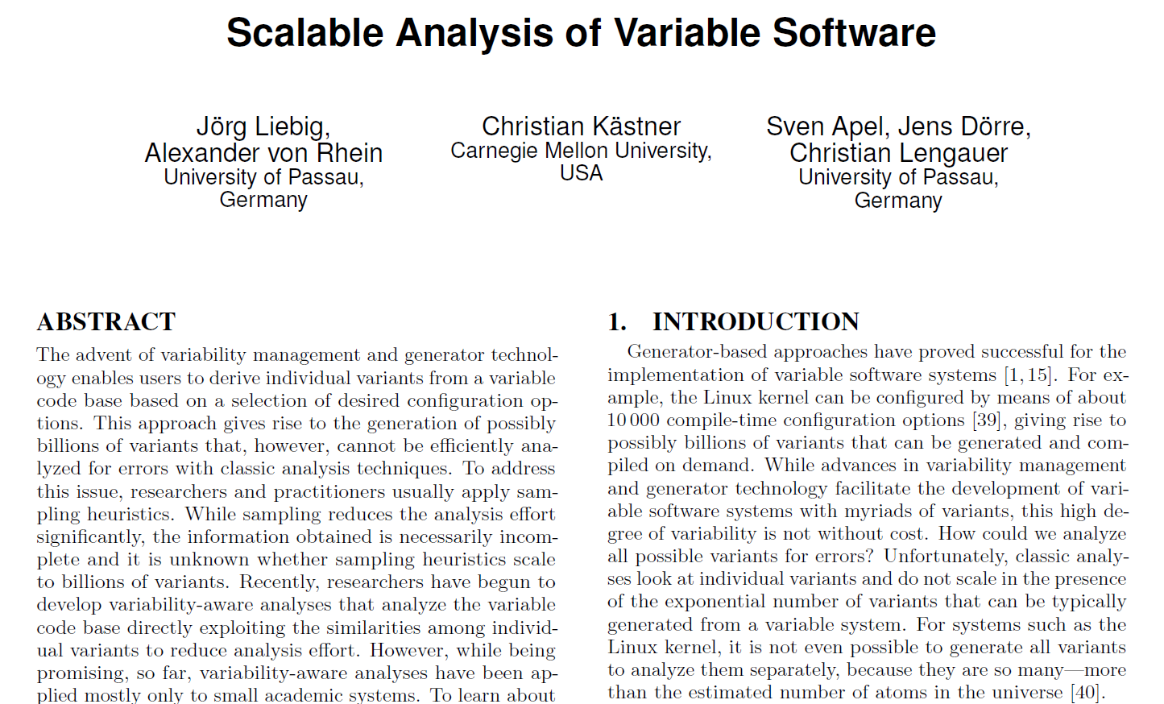
ESEC/FSE’13

Slide 16
Scalable Analysis of Variable Software
Sampling Strategies:
Single configuration
Random
Code-coverage based
Pair-wise
Variability-aware data structures:
Abstract Syntax Tree (AST)
Control Flow Graph (CFG)
Symbol Table
Analyses:
Type checking
Liveness analysis

Slide 17
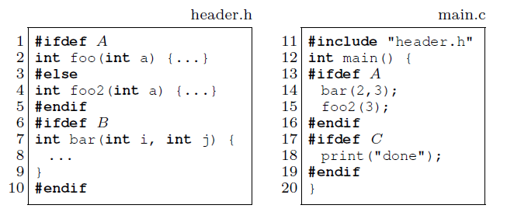
Example
Sampling Strategies:
Single-conf (e.g. {B,C})
Random
Code-coverage (e.g. {}, {A,B,C})
Pair-wise ({}, {A,B}, {B,C}, {A,C})
Annotative SPL (3 optional features)

Slide 18
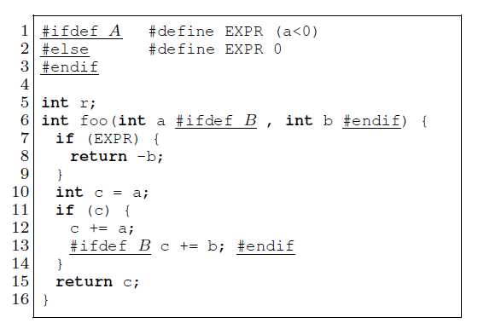
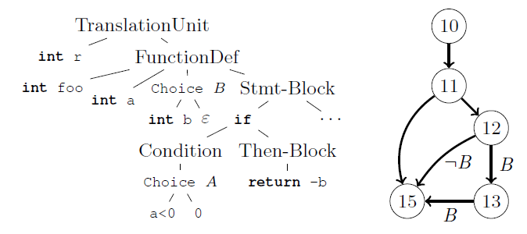
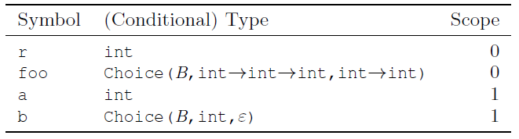
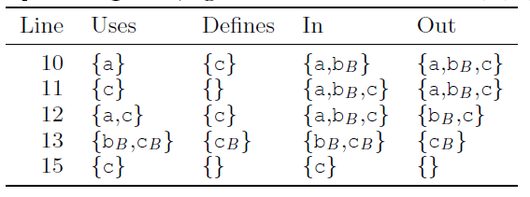
Variability-Aware Data Structures
Notes:
Abstract Syntax Tree (AST)
Control Flow Graph (CFG)
Symbol Table
Liveness computation def-use

Slide 19
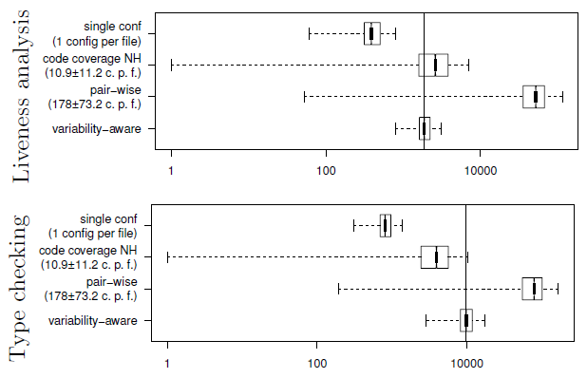
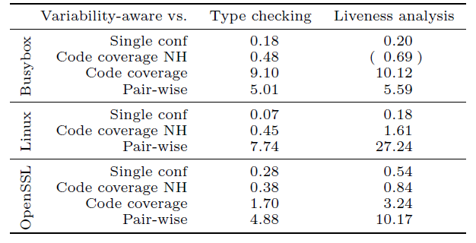
Evaluation
Notes:
Busybox – 792 features, FM: 993 clauses, ~192KLOC, 522 files
X86 Linux kernel - ~7000 features, FM: 300K clauses, ~6.5MLOC, 7691 files
OpenSSL – 589 features, FM: 15 clauses, ~233KLOC, 733 files
Speedup
NH: No Headers
Log scale, time in milliseconds,

Slide 20
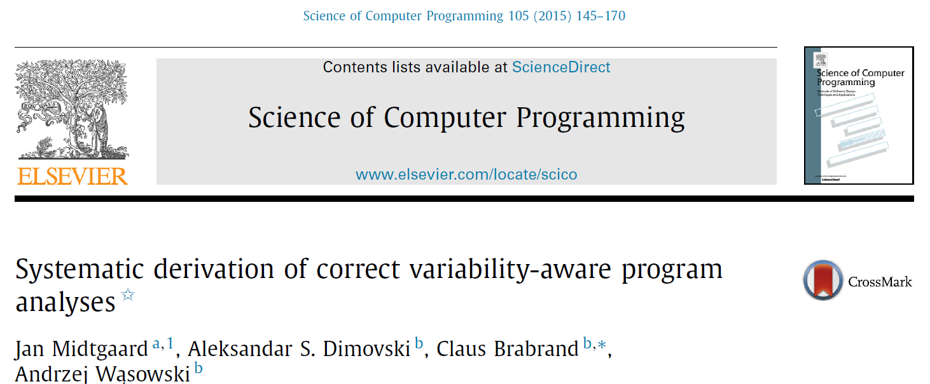
SoCP’15

Slide 21
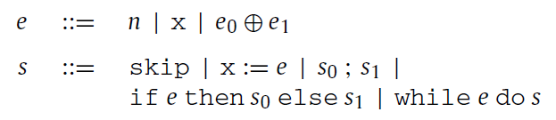
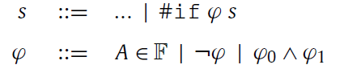
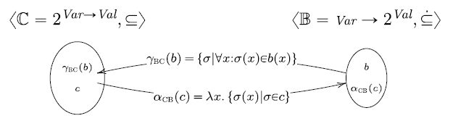
Abstract Interpretation
Imperative language (annotative)
Semantics in terms of (Variable, Value) stores
Notes:
Galois Connection: monotones

Slide 22
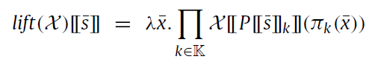
Variability-Aware Abstract Interpretation
Lifting combinator (a tuple of values, one per configuration):
Optimization: value sharing (shorter tuples)
Lossy optimization: variability abstraction
Compositionality of Galois connections
Minimum abstraction: fully preserves variability
Maximum abstraction: map all configurations into one
Notes:
K: set of configurations
P: preprocess a program in a specific configuration k
Pi: projection
x-bar: lifted store

Slide 23
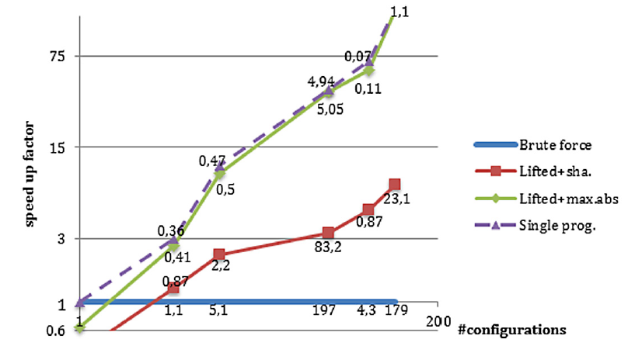
Evaluation
Notes:
Reaching definitions intraprocedural analysis
3 Java SPLs: Graph PL (GPL), Prevayler, and BerkelyDB
For N = 4, 8, 40, 72, and 106
Running time in ms

Slide 24
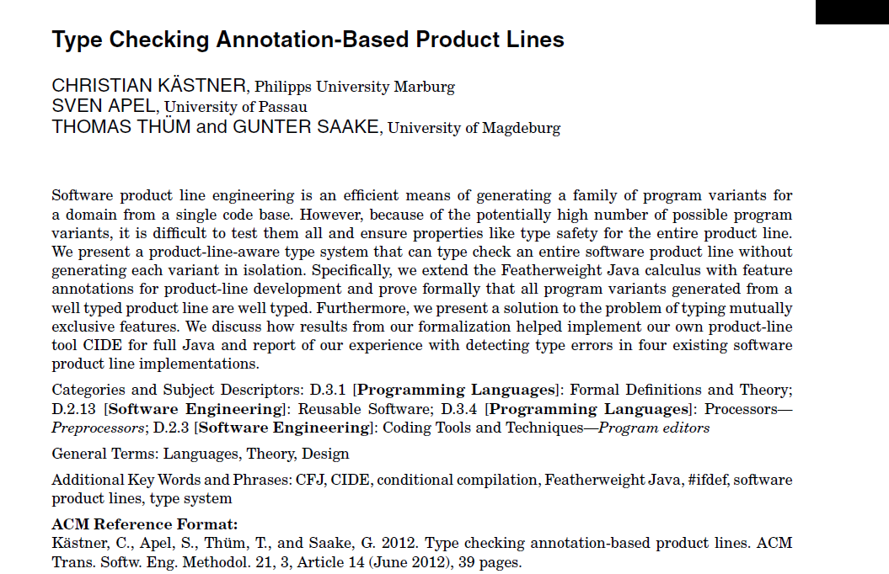
TOSEM’12

Slide 25
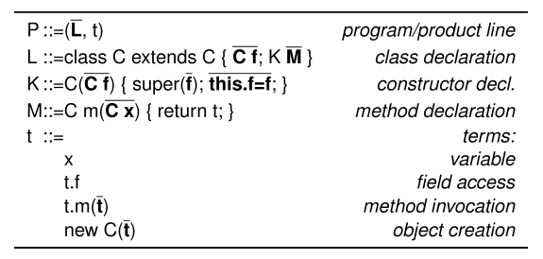
Product Line Type Checking
Colored Featherweight Java (CFJ) (annotative – limited)
Goals:
Product generation preserves typing
Backward compatibility (extends the Java Type System)
Type Checking: reachability rules (target reachable from reference)

Slide 26
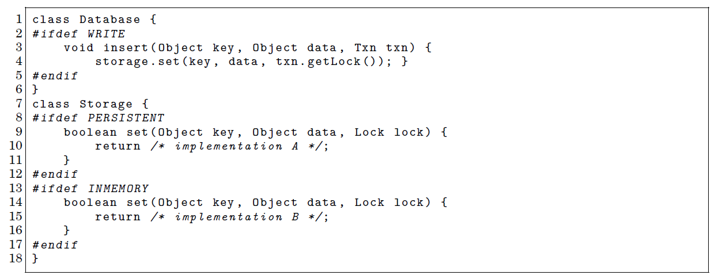
Example

Slide 27
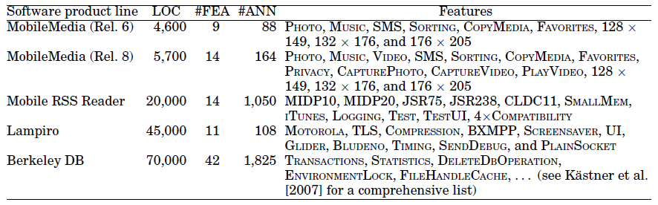
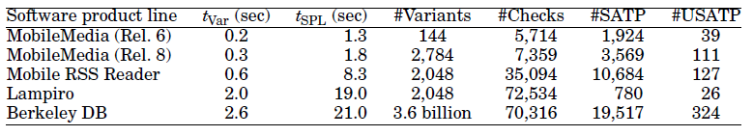
Evaluation
Notes:
#FEA: # of features
#ANN: # of annotated fragments
t-var: time to compile a single variant
t-SPL: time to check the whole SPL
#Checks: number of reachability checks
#SATP: number of SAT queries
#USATP: number of unique SAT queries

Slide 28
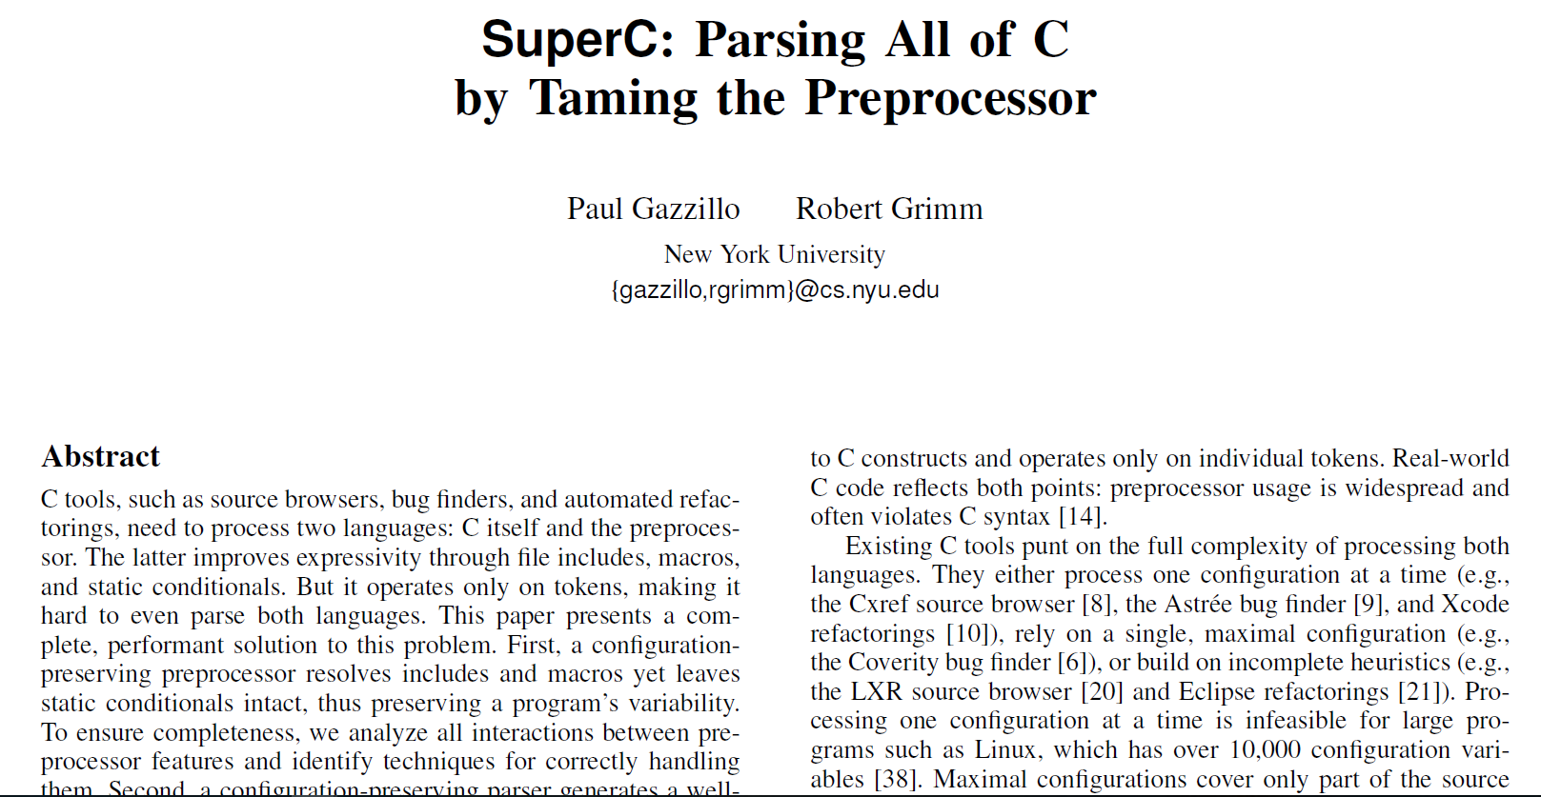
PLDI’12

Slide 29
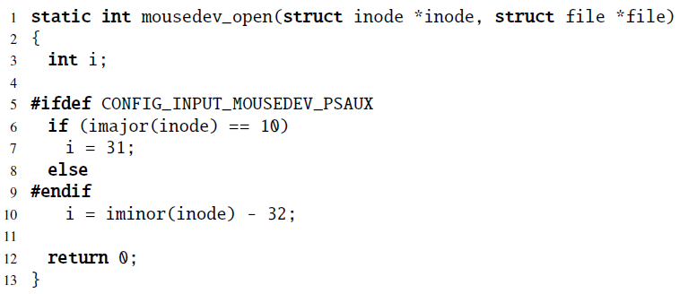
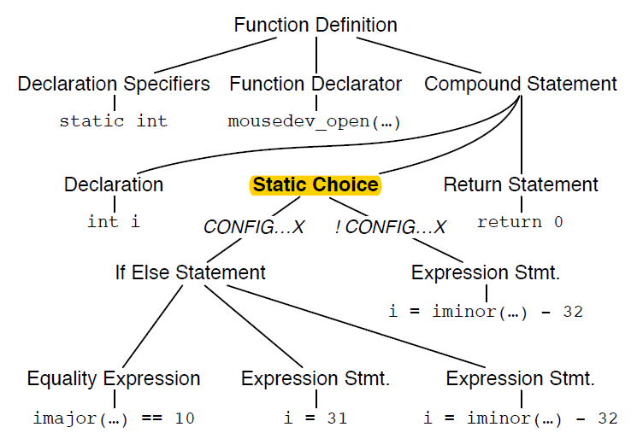
SuperC
Notes:
Disciplined vs. undisciplined annotations

Slide 30
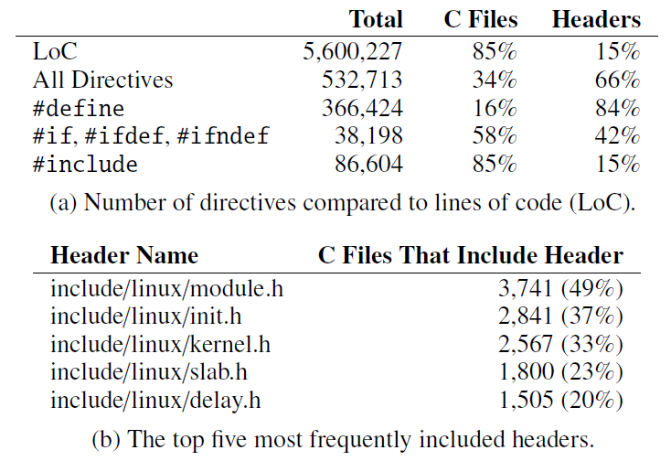
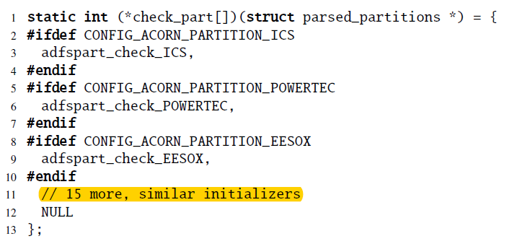
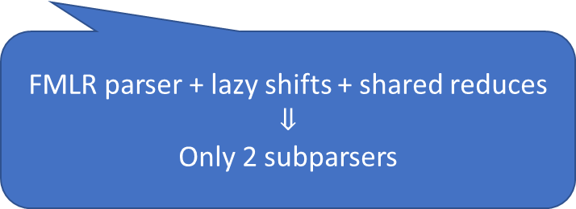

Example: x86 Linux kernel
block/partitions/check.c:
$2^{18}$ unique configurations
FMLR parser + lazy shifts + shared reduces
$$⇓$$
Only 2 subparsers
Notes:
FMLR – Fork-Merge LR parser

Slide 31
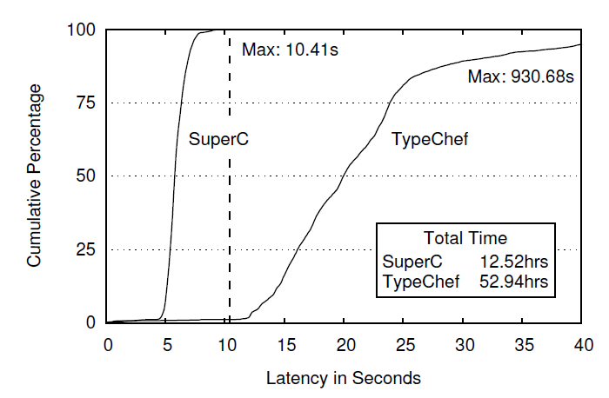

Evaluation

Slide 32

PLDI’13

Slide 33

Example
Secret is leaked!!

Slide 34


SPL^{LIFT}
Notes:
IFDS – Interprocedural, Finite, Distributive Subset problems
Interprocedural, flow-sensitive

Slide 35


Evaluation
Notes:
A1 – brute force generation of all configurations, followed by analysis
A2 – similar to A1, except that parsing and call graph computation are done only once

Slide 36

TSE’13

Slide 37

Example

Slide 38

Featured Transition Systems
Feature LTL (fLTL) – LTL expressions enriched with feature expressions
fPromela
SNIP model checker

Slide 39


Evaluation
Notes:
Mine pump model: 11 features, 128 products
Log-scale
Only a sample of properties being checked
enum(snip): naïve snip without FTS algorithm
enum(spin): naïve spin
Pan: process analyzer

Slide 40
My Ongoing Research: Can we automatically lift analyses to SPLs?

Slide 41

Typed Lambda Calculus
Terms:
Values and variables: 1 :: Int, true :: Bool, x :: Int
Lambda abstractions: $λx. λy. x+y$ :: Int -> Int -> Int
Lambda application: $\left(λx. λy. x+y\right) 5 8$ :: Int
Computationally equivalent to Turing Machines and all Turing-complete languages
Other programming constructs built on top

Slide 42

Lifting Basic Types
F = {A,B}
x = [(1,A), (-2,$¬A∧B$), (3, $¬A∧¬B$)] x :: Variant Int
y = [(5, $A∧¬B$), (4,B), (-3, $¬A∧¬B$)] y :: Variant Int
z = [(“hello”, True)] z :: Variant String
For any type t:
type Variant t = [(t, PresenceCondition)]
Disjointness Invariant:
Given a lifted value $v=\left[\left(v_{1},pc_{1}\right), …\left(v_{n}, pc_{n}\right)\right]$, $∀i≠j,$unsat($pc_{i}∧pc_{j}$)

Slide 43
Lifting Values
lift :: PresenceCondition -> t -> Variant t
lift pc x = [(x, pc)]
Example: lift True 7 => [(7, True)]
liftT :: t -> Variant t
liftT x = lift True x

Slide 44

Lifting Unary Functions
abs (-3) => 3
x = [(1,A),(-2,$¬A∧B$),(3, $¬A∧¬B$)]
liftedAbs = liftT abs => [(abs, True)]
apply liftedAbs x => [(1,A), (2,$¬A∧B$), (3, $¬A∧¬B$)]
apply :: Variant (a -> b) -> Variant a -> Variant b
apply fn x = [ (fnVal xVal, conj [fnPC,xPC])
| (fnVal,fnPC) <- fn,
(xVal,xPC) <- x,
sat(conj[fnPC,aPC])]

Slide 45




Lifting Binary Functions
F = {A,B}
x = [(1,A),(-2,$¬A∧B$),(3, $¬A∧¬B$)]
y = [(5, $A∧¬B$),(4,B),(-3, $¬A∧¬B$)]
x + y => ??
liftedPlus = liftT (+) => [((+), True)]
liftedPlus :: Variant (Int -> Int -> Int)
apply liftedPlus x => [(+ 1, A), (+ -2, $¬A∧B$), (+ 3, $¬A∧¬B$)]
apply (apply liftedPlus x) y =>
[(+ 1 5, A $∧A∧¬B$), (+ -2 5, $¬A∧B∧$ $A∧¬B$), (+ 3 5, $¬A∧¬B$ $∧A∧¬B$),
(+ 1 4, A $∧$B), (+ -2 4, $¬A∧B∧\text{B}$), (+ 3 4, $¬A∧¬B∧\text{B}$), (+ 1 -3, A $∧¬A∧¬B$), (+ -2 -3, $¬A∧B∧$ $¬A∧¬B$), (+ 3 -3, $¬A∧¬B∧¬A∧¬B$)]
apply (apply liftedPlus x) y =>
[(+ 1 5, A $∧A∧¬B$), (+ -2 5, $¬A∧B∧$ $A∧¬B$), (+ 3 5, $¬A∧¬B$ $∧A∧¬B$),
(+ 1 4, A $∧$B), (+ -2 4, $¬A∧B∧\text{B}$), (+ 3 4, $¬A∧¬B∧\text{B}$), (+ 1 -3, A $∧¬A∧¬B$), (+ -2 -3, $¬A∧B∧$ $¬A∧¬B$), (+ 3 -3, $¬A∧¬B∧¬A∧¬B$)]
apply (apply liftedPlus x) y =>
[(6, $A∧¬B$), (5, A $∧$B), (2, $¬A∧B$), (0, $¬A∧¬B$)]

Slide 46
Lifting Functions of Other Arities
apply2 :: Variant (a -> b -> c) -> Variant a -> Variant b -> Variant c
apply2 fn a b = apply (apply fn a) b
apply3 :: Variant (a -> b -> c -> d) ->
Variant a -> Variant b -> Variant c -> Variant d
apply3 fn a b c = apply (apply2 fn a b) c
apply4 :: Variant (a -> b -> c -> d -> e) ->
Variant a -> Variant b -> Variant c -> Variant d -> Variant e
apply4 fn a b c d = apply (apply3 fn a b c) d
…

Slide 47
Lifting Conditional Expressions
cond :: Bool -> t -> t -> t
cond p a b = if p then a else b
condLifted :: Variant Bool -> Variant t -> Variant t -> Variant t
condLifted = apply3 (liftT cond)

Slide 48

Lifting Conditionals - Example
F = {A,B}
x = {(1,A),(2,$¬A∧B$),(3, $¬A∧¬B$)}
y = {(5, $A∧¬B$),(4,B),(3, $¬A∧¬B$)}
if (x == y) then (x + y) else (x - y)
liftedEq a b = apply2 (liftT (==)) a b
liftedPlus a b = apply2 (liftT (+)) a b
liftedMinus a b = apply2 (liftT (-)) a b
condLifted (liftedEq x y) (liftedPlus x y) (liftedMinus x y)

Slide 49
Challenges
Lifting building blocks
Data structures
Parsers
Optimizations
Lazy evaluation/lazy data structures
Value sharing
BDDs vs SAT solvers
Analyses written in a functional language (side-effect free)

Slide 50
Current Status
A prototype Variant library in Haskell
Correctness proof of the lifting algorithm
Variability-aware data structure optimizations – under development
Lifting assurance case analyses – ongoing work with General Motors
Optimize the cost of SAT queries in lifted analyses – course project
Lifting rewrite engine – to be developed

Slide 51
Questions

